Slide 1
IMPLEMENTATION OF BIOLOGICAL WEAPON CONVENTION(BWC) IN QATAR
Dr NaserAli Al-Ansari
Consultant Medical Microbiologist & Infection Control
Al Wakra Hospital - HMC
Qatar

Slide 2
Article IV
Each State Party to this Convention shall, in accordance with its constitutional processes, take any necessary measures to prohibit and prevent the development, production, stockpiling, acquisition, or retention of the agents, toxins, weapons, equipment and means of delivery specified in article I of the Convention, within the territory of such State, under its jurisdiction or under its control anywhere.
Article IV
To take any national measures necessary to implement the provisions of the BWC domestically.

Slide 3
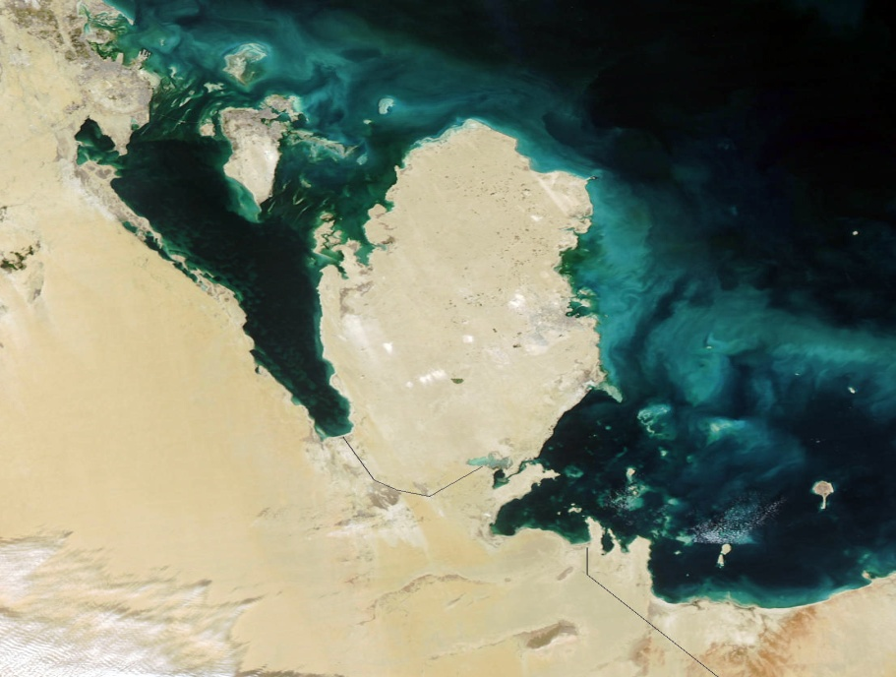

Slide 4
Confidence-Building Measures (CBMs)
These consist of annual exchanges of data and information, as well as declarations of past and present activities of relevance to the Convention.
The measures include:
Measure A, Part 1
Exchange of data on research centres and laboratories that meet very high national or international safety standards (WHO BL4/P4).
Measure A, Part 2
Exchange of information on national biological defence research and development (R&D) programs, including declarations of facilities where biological defence R&D programs are conducted. This measure also includes information relating to contractors and on available publications.

Slide 5
Measure B
Exchange of information on outbreaks of infectious diseases and similar occurrences caused by toxins that seem to deviate from the normal pattern.
Measure C
Encouragement of publication of results of biological research directly related to the Convention and promotion of use of knowledge.
Measure D
Active promotion of contacts between scientists, other experts and facilities engaged in biological research directly related to the Convention, including exchanges and visits for joint research on a mutually agreed basis.

Slide 6
Measure E
Declaration of legislation, regulations and other measures including exports and/or imports of pathogenic micro-organisms in accordance with the Convention.
Measure F
Declaration of past activities in offensive and/or defensive biological R&D programmes since 1 January 1946.
Measure G
Declarations on vaccine production facilities, licensed by the State Party for the protection of humans.

Slide 7
Form A Part 1
Exchange of data on research centres and laboratories1
1. Name(s) of facility2 Health Protection Agency, Colindale
2. Responsible public or private Health Protection Agency (a non-departmental
organisation or company public body of the UK Department of Health)
3. Location and postal address 61 Colindale Avenue,London,NW9 5HT,England
4. Source(s) of financing of the reported activity, including indication if the activity is
wholly or partly financed by the Ministry of Defence
The Department of Health funds this activity as part of its finance of the Health
Protection Agency’s Centre for Infections at Colindale, London NW9

Slide 8
5. Number of maximum containment units3 within the research centre and/or laboratory, with an indication of their respective size (m2)
1 high containment unit: 30m2
6. If no maximum containment unit, indicate highest level of protection
Not Applicable
7. Scope and general description of activities, including type(s) of micro-organisms and/or toxins as appropriate
Laboratory is used to provide diagnostic services for Herpes B; viral haemorrhagic fever infections: Lassa fever, Ebola, Marburg, Congo-Crimean haemorrhagic fever; avian influenza and SARS. To support diagnostic services a programme of applied diagnostic research and development is conducted

Slide 10
UNSCR 1540
Urges States to take preventative measures to mitigate the threat of WMD proliferation by non-state actors
States required to
Establish and enforce legal barriers to acquisition of WMD by
terrorists and states
Submit reports to the 1540 Committee on efforts to comply
Paragraph 3 is the key provision that supports biosecurity
“Take and enforce effective measures to establish domestic controls
to prevent the proliferation of . . . biological weapons . . .; including by
establishing appropriate controls over related materials”
• Develop and maintain appropriate effective measures to account for and secure such items in production, use, storage or transport
• Develop and maintain appropriate effective physical protection measures

Slide 11
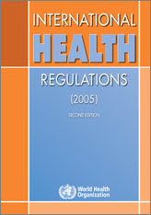
WORLD HEALTH ORGANIZATION ( WHO)
Infectious disease surveillance
Diagnostic laboratories
National preparedness
Response

Slide 12
Governance - Medical Research
Managing Director
Ultimate responsibility and control for governance
Institutional Review Board (IRB)
Informed consent
Research Strategy and Assurance Committee (RSAC)
Strategic fit of research into HMC’s overall strategy.
Medical Research Center (MRC)
Executive Management Committee (EMC)
Governs RSAC and IRB
Ethics review
No scientific or funding decisions
AWH & TCH Medical Research and Education Committee (MREC)
Administrative role
Organizes peer review process and committee.
Approves clinical aspects of the research and the study paperwork, including information about the intended clinical facilities and practices
AWH Nursing / Pharmacy (Hospital Specialty) Research Committee
Promote and facilitate specialty specific research projects.
Checks research documentation
No scientific or ethical decisions about research studies.
Overseas research budget
No scientific or funding decisions about the study.
Source: HMC E-Learning Research Module, 2015

Slide 13
Oversight of science
Institutional review board
Awareness raising symposium

Slide 14
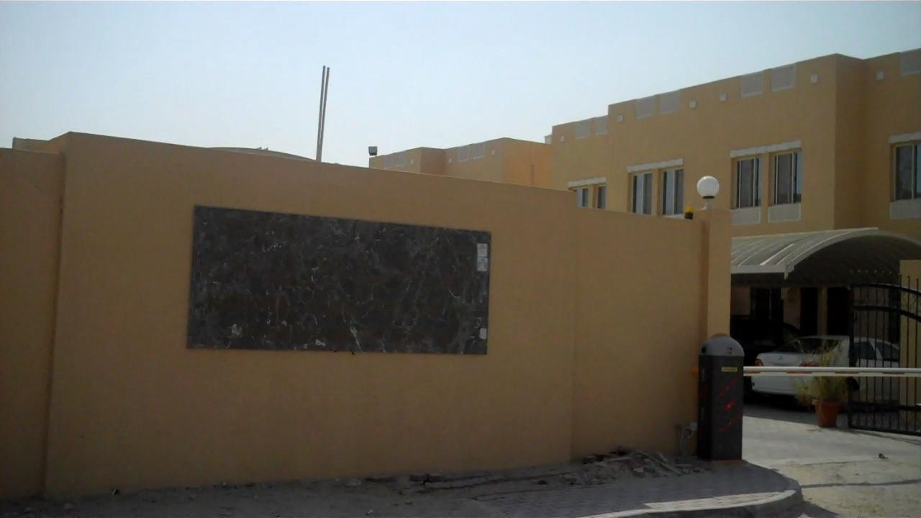

Slide 15
The National Committee for the Prohibition of Weapons
Established in the Ministry of Defense as a standing committee pursuant to resolution no. (26) Of the Cabinet for the year 2004, later was amended by the resolution no. (45) For the year 2007.
The establishment resolution has stated the formation of the committee board as follows : two representatives from the Ministry of Defense (the committee head , his deputy ) and nine members representing the Ministry of Foreign Affairs, the Ministry of Interior, the Ministry of Energy and Industry, the Ministry of Public Health, the Ministry of Municipality , the Ministry of Environment, Cabinet's General Secretariat, Hamad Medical Corporation and Customs & Ports General Authority) .
An officer from the ministry of defense was appointed as the committee’s secretary general.

Slide 16
SCOPE OF WORK
1-Providing advice to the relevant ministries and governmental bodies, on the field of prohibition of all forms of weapons including nuclear, biological, toxic, chemical and conventional weapons.
2- Studying the draft international conventions on the prohibition of weapons and shape an opinion on suitability to join
3-Working on achieving the mentioned objects of the global treaties related to the prohibition of all forms of weapons which the country has joined and approved.
4-Suggesting the necessary legislations and procedures for the implementation of the global treaties related to the prohibition of weapons.
5-Revising the national legislation pertaining to the illegal trade of weapons and suggesting effective ways of enhancing and modifying them.
6-Preparing the reports pertaining to the prohibition of weapons which the State shall propose to the international committees in accordance with the relevant international treaties and resolutions.

Slide 17
7-Preparing and implementing the necessary awareness programs on the content of the international treaties pertaining to the prohibition of weapons.
8-Working as a center to ensure effective communications between the State and the Origination Prohibition Chemical Weapons , and the member States in the treaty for the prohibition of development, production, stockpiling and use of chemical weapons, and to work on their destruction .
9- Issuing certificates containing the data for the end user of the scheduled which are imported by a third party.
10- Monitoring and controlling the import, export, manufacturing, preparation, and consumption of the chemical substances that are listed in the treaty annexed chemical schedules, in addition to some discrete organic chemicals or those containing phosphorus or sulfur or fluoride(as defined in the convention).
11-The quarantine of the banned substances which are listed in the schedule appended to the CWC, until a decision is made in their regard.
12-Giving opinion on the applications to obtain licenses to conduct any of the works or practices mentioned in article 4 of the law no. (17) Of the year (2007).
13- Participating in the international and regional conferences and meetings relevant to the prohibition of weapons.

Slide 18
Laws & Legislations
1 - Establishment of the committee resolution No. 26 of year 2004 and modified by the resolution 45 in 2007.
2 - Chemical Weapons Act No. 17 for the year 2007.
3 - Draft amendment of the Chemical Weapons Act. (At issuance stage)
4 - Draft of biological weapons Act. (At review stage)
5 - Draft of the National program for controlling Nuclear Materials. (At review stage)
Chemical weapons legislation (law) was the first..Why?

Slide 19
Declarations and official inspections
• The Primary declaration on 04/06/2004.
•The Second annual declaration in 2005 for chemical substances and facilities.
• The Third annual declaration in 2006 of chemical substances and facilities.
• The Fourth annual declaration in 2007 of chemical substance and facilities.
•the Fifth annual declaration in 2008 of chemical substances and facilities.

Slide 20
Inspections:
• The first inspection was during (20-25) November 2005 which covered the following plants:
I. Qatar Fertilizer Company (QAFCO)
II. Qatar Detergent Company (QDC)
• The second inspection was during the period 29-31 July 2007 which covered Qatar Vinyl Co. (QVC)
• The third inspection was during the period from 7-9 October 2007 which covered Fuel Additives Company (QAFAC)

Slide 21
Education and Training
Event | Date
Basic and advanced course (protection against chemical weapons) | 6-14/07/2004).
Regional workshop on legislation and measures concerning the implementation of the Convention on the Prohibition of Chemical Weapons | 14-17/3/2005
A special seminar for officers and units commanders responding (protection against chemical weapons) | 20-23/3/2005
Security alert Symposium (Asiad 2006- Doha) under the supervision of the Athens Olympic Games in 2004 to combat chemical terrorism | 3-4/4/2005

Slide 22
Event | Date
Three special courses for the rehabilitation of chemical control team in preparation for the Doha Asian Games "Doha Asiad in 2006," included (25) trainees per course, • The First: • The second • The Third | 13 - 24/8/2005 14 - 24/11/2005 21 - 25/5/2006
Training Course for the analysis of chemical substances used in chemical weapons, held in (Slovakia), and was attended by (15) participants from Qatar armed forces and some of Qatari governmental bodies and ministries | 26/11 - 01/12/2006

Slide 23
The Committee hosted the Fifth Regional Meeting of National Authorities of Asian States Parties, held in Doha | 4-6 / 09/2007
NCPW organized An industrial awareness workshop on the Prohibition of Chemical Weapons Convention and its applications | 25-26/03/2008
Five members of the committee participated in a training course in Argentina for the members of the national authorities in the field of hosting inspectors who work in compliance with the treaty for prohibition of chemical weapons | 26/03-04/04/2008

Slide 24
Training Course for national authorities in Asia on the imlementationof the Convention of the Prohibition of Chemical Weapons | 19-24/10/2008
Sub-Regional training course for customs authorities of the GCC countries on the technical aspects of transfers regime | 26-28/10/2008
Participation in a special training course of the Chemical profile of the intelligence and security department for a number (15) individuals, which was held in (Slovakia) | 9-14/11/2008
Workshop on nuclear radiation / NATO | 24-25/11/2008

Slide 25
Workshop-first session on the coordination of assistance and protection in accordance with Article X of the Convention on the Prohibition of Chemical Weapons | 1-3/10/2009
Sub-Regional training course for customs authorities of the GCC countries on the technical aspects of transfers regime | 04-05/11/2009
Workshop on advanced analytical skills, Finland, | 23/11 - 04/12/2009

Slide 27
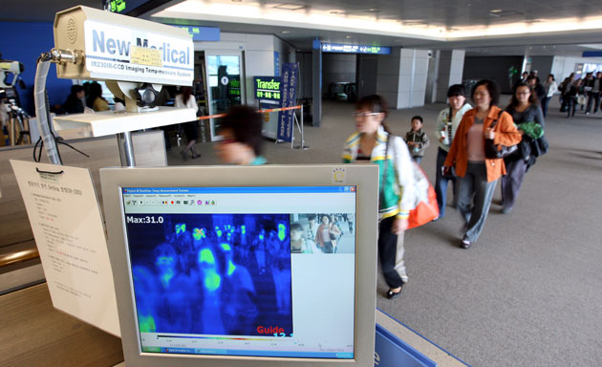

Slide 28
Definition
“Biosecurity measures protect infectious agents and toxins against theft or sabotage”
“Biosafety practices are designed to protect laboratory workers, the public, and the environment from accidental exposure to infectious agents and toxins”
Biosecurity and Biosafety

Slide 29
Biosecurity situation in Qatar
Inspection of academic animal and human laboratories
Letters sent to
Hamad Medical Corporation
Ministry of environment
Qatar University

Slide 30
The Australian group
Informal forum of countries
created in 1985
harmonisation of export controls
Participants
Australia , Belgium, Canada, Cyprus, Denmark, France
Greece, Iceland, Italy, Argentina, Korea, Austria, Lithuania, Bulgaria , Malta, Croatia , New Zealand
Czech , Poland, Estonia , Romania, Finland , Slovenia
Germany ,Sweden, Hungary , Turkey, Ireland, United Kingdom, Japan

Slide 32
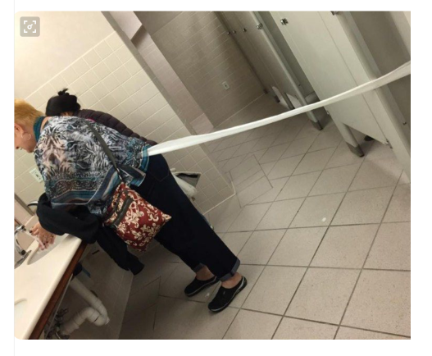

Slide 33
